Slide 1


AI Proof of Data Ownership
New York 2023

Slide 2
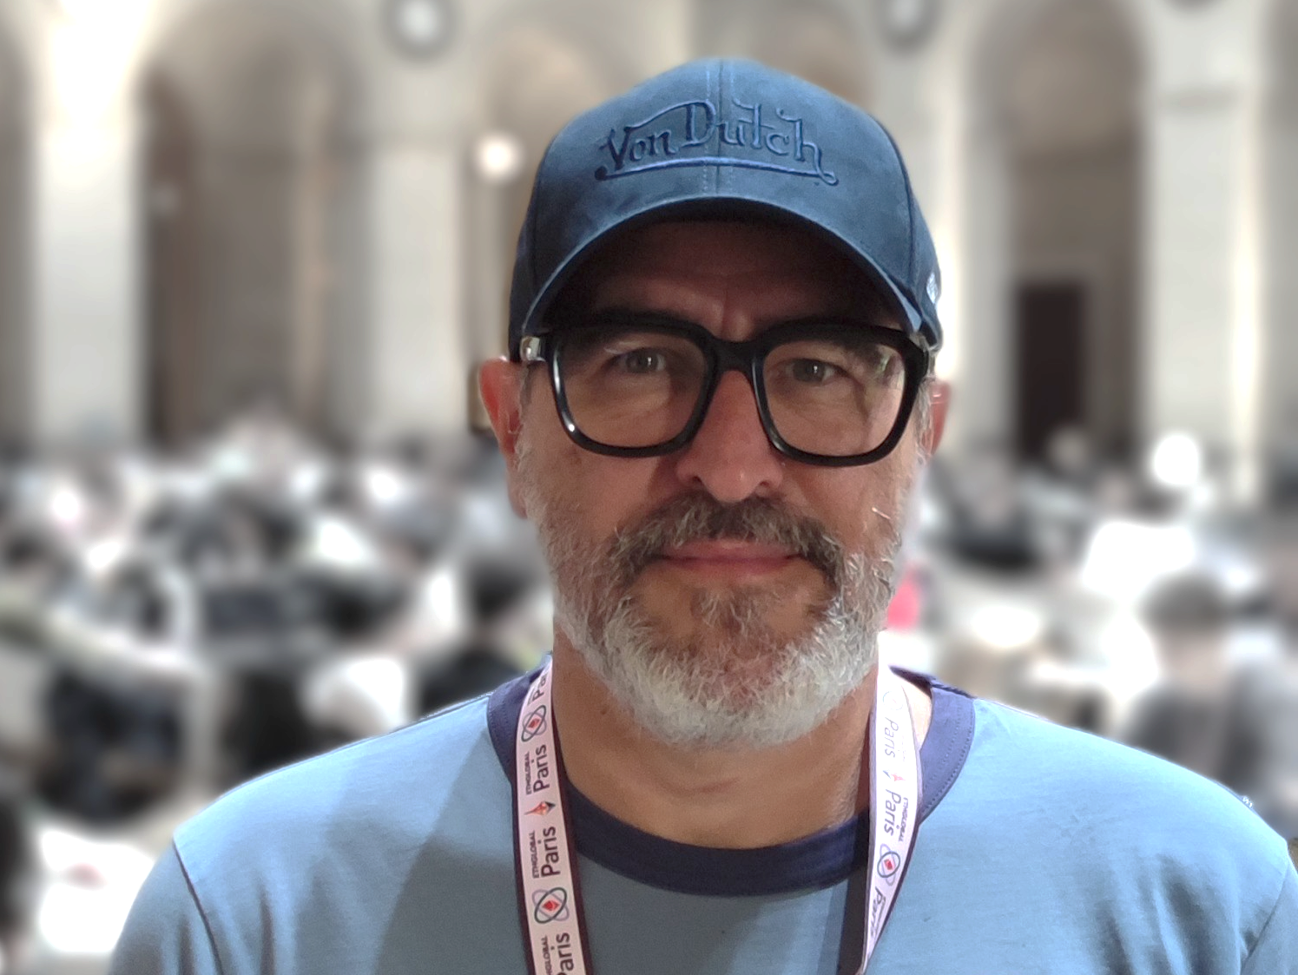
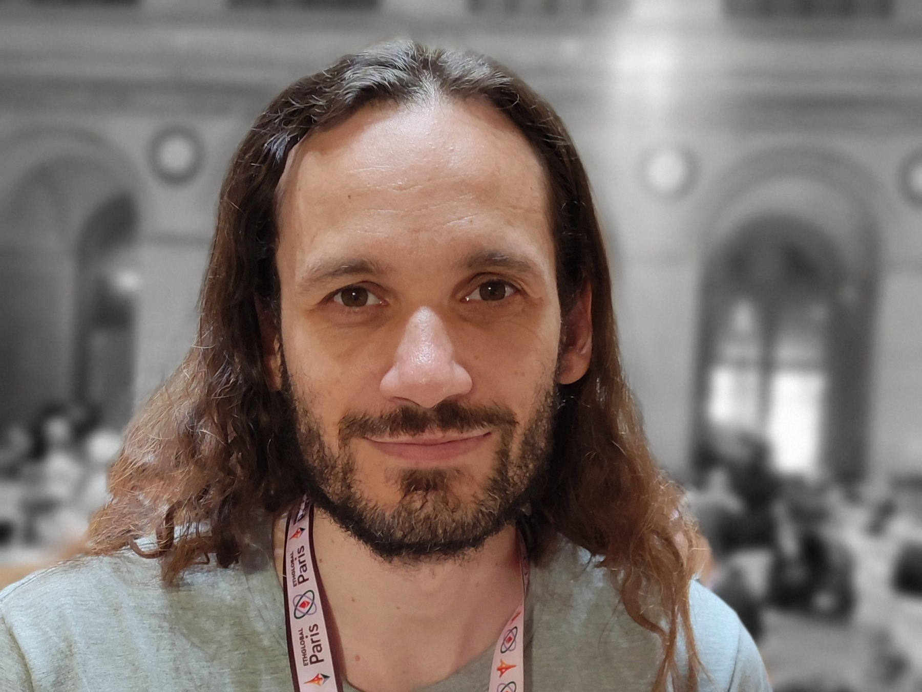

Who are we ?
Patrick Escande
Product Manager
Jérôme Rastit
Fullstack Developer
Xavier Fournet
Fullstack Developer
New York 2023

Slide 3
What we built?
A way to track the ownership of a Machine Learning model training and its dataset.
Establishing ownership rights for its owner and contributors.
Enabling them to receive revenue from its usage.

Slide 4
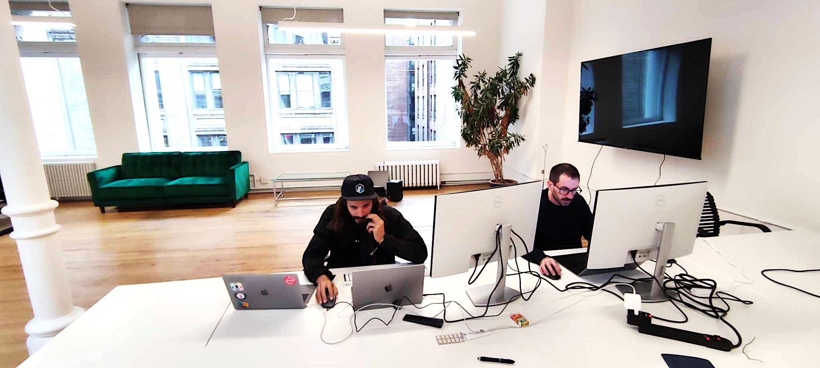
Why we made it ?
Blockchain is good for micro contract/transaction. It gives the possibility to pay in a simplessway for ownership to a multiple people.
Blockchain data are timestamped and add traceability to the process. Data provider and workers can prove they contribution and ask part of the final payment with hash stored within the blockchain.
Final customer can track the data ownership and make sure they have the right to use them.

Slide 5
What problem we resolve?
AI model require a huge amount of data. And with advanced model like chatgtp/bard/… it need multiple dataset that are provided by multiple sources.
Different work has to be done to clear all thoses dataset and provide a fully curated/tagged dataset for a model trainning.
Model have to be trained with high level of exeprtise on parameters and as well on high cost machines.
Giving prove of ownership and payment open the way to trusted AI when we can appropriate the result without fear

Slide 6
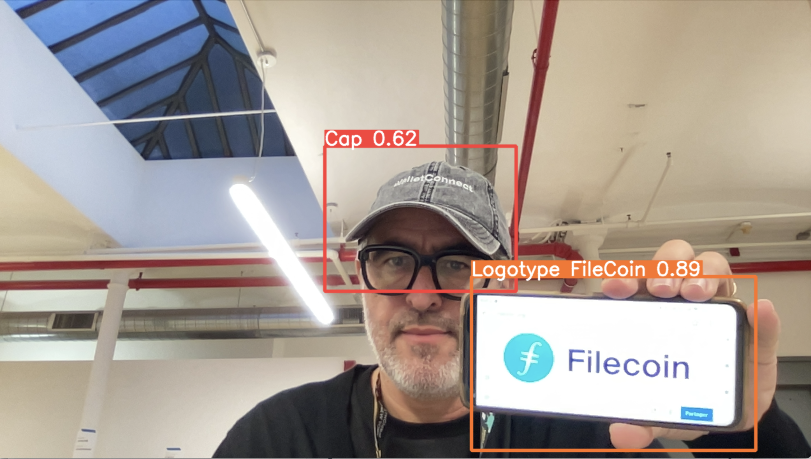
AIPoDo Features
AI Proof of Data Ownership
Dataset 1
Certify a dataset
Obtain a license/smart contract for the dataset
Add work to a dataset
Modify the license/smart contract of the dataset based on the work
Track the dataset's history and its contributors
Buy the dataset, and remunerate the contributors
Dataset 2

Slide 7
Ownership, Trust & Price
Ownership is proved with a hash of the total data
Data can be split with a merkel tree into subsets
Data ownership can be evaluate when changes are made on the % of the difference.
Prove you are human and qualify
Trust score
Prove you own the dataset
Prove you own the work done (data tag/model/aggregation/…)
Prove you own the result of IA work
Prove dataset/work is stollen
Data price can be set by the producer.
It is base on a fix price.
It can chose to reduce price for reusing his work with another work.
It can have two corposant in prices, price to buy and price to use.
Prices are combined as a tree to fix a final price.

Slide 8

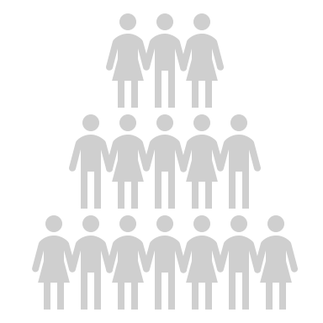
How it works ?
Block
Block
Block
Block
Smart Contrat
Owner A
Contributor A
Contributeur C
Contributeur D
Pay A,B,C,D,E,F,G
Own work result from
Hash 1,2,3,4,5,6,7
Price A
Hash 1
Price D
Hash 1 + 2
= Hash 3
Price F
Hash 6
Price G
Hash 7
User
Owner B
Prove that you own the result
because you have pay the data and the work
Price B
Hash 2
Contributeur B
Price E
Hash 4
Payments
Owner C
To avoid multiple transaction for data usage as there will be small contributor
Payment are made to a smart contract that represent the tree.
Money is lock within the smart contract.
The owner can retrieve the money when he think it worth.
He can retrieve a % of the total deposit depending of his contribution.
Contribution are withdraw chained throw the tree.
Price C
Hash 3
Owner
Dataset

Slide 9
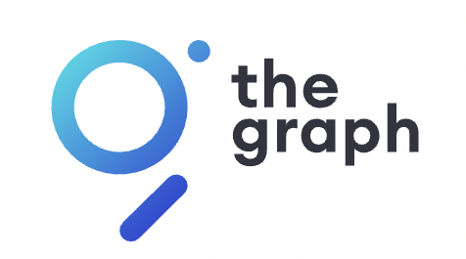


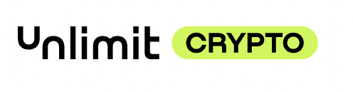


Stack & Sponsors
Data provider
Data expert
Model trainner
Model runner
Owner – Co-Owner
User
Data indexing
Proof of human activity
Connect to the Blockchain
FIAt to Crypto
Data aggregation
Blockchain
Blockchain
Cross chain

Slide 10
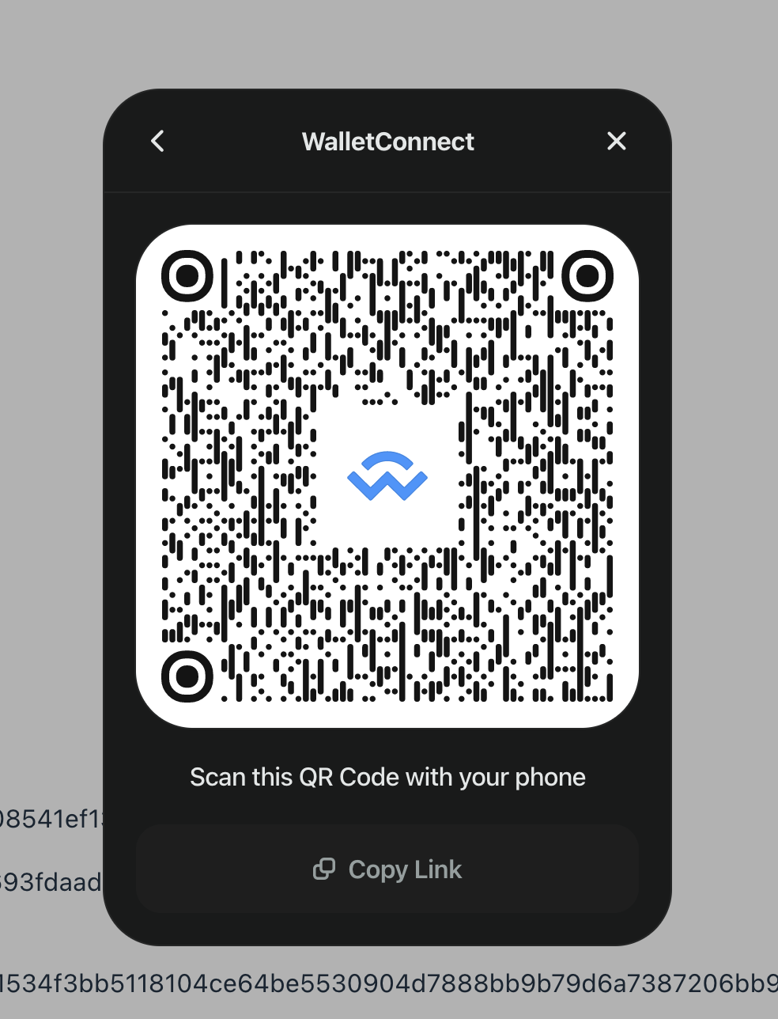
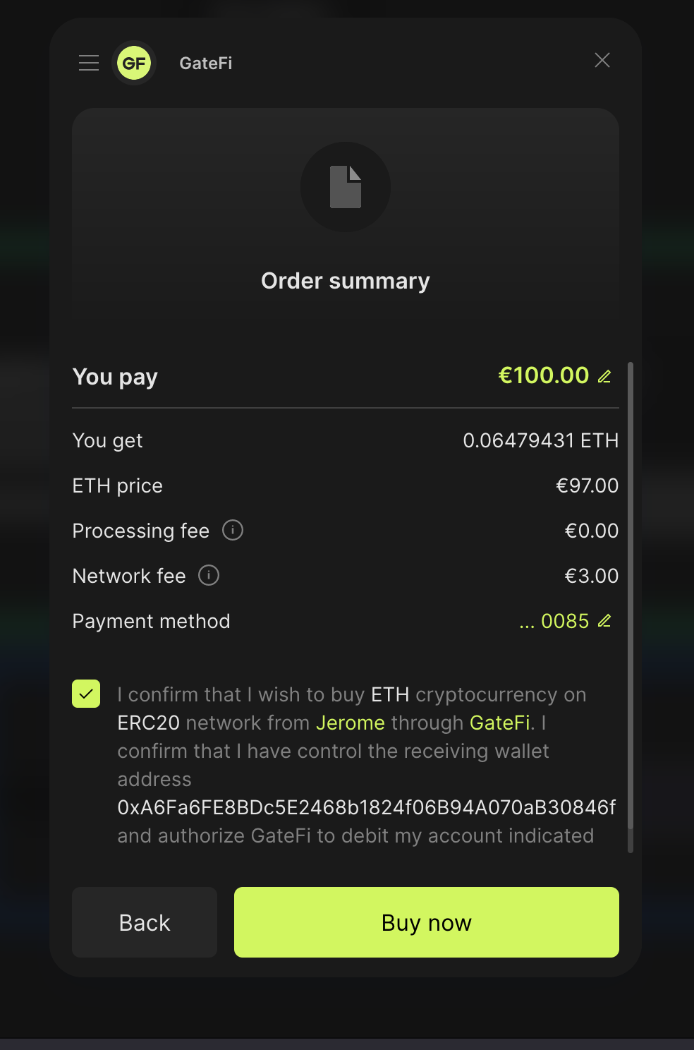
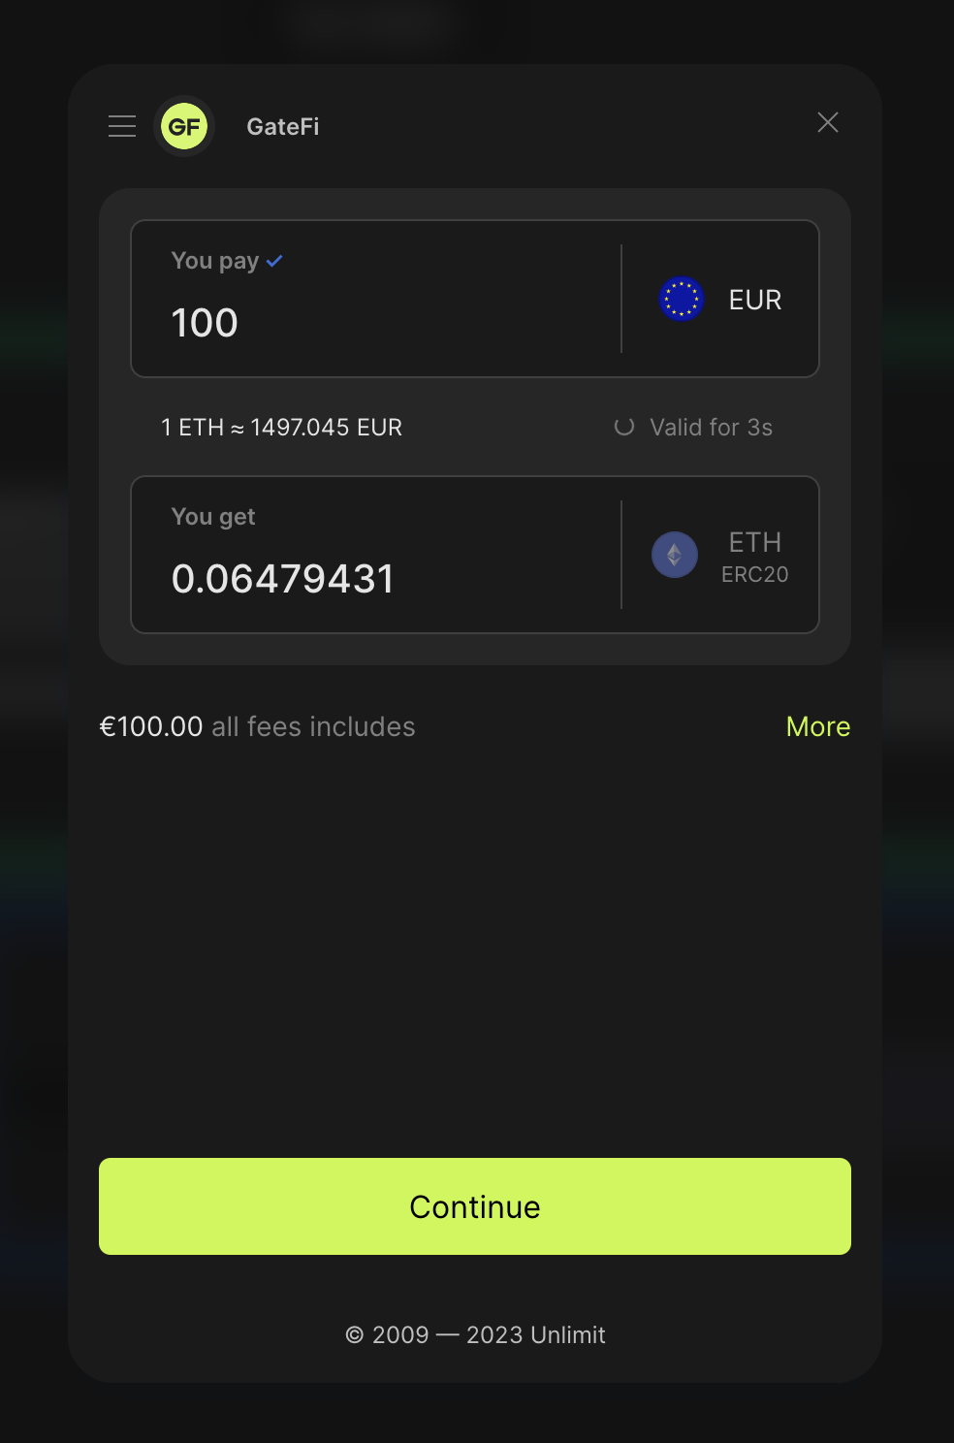
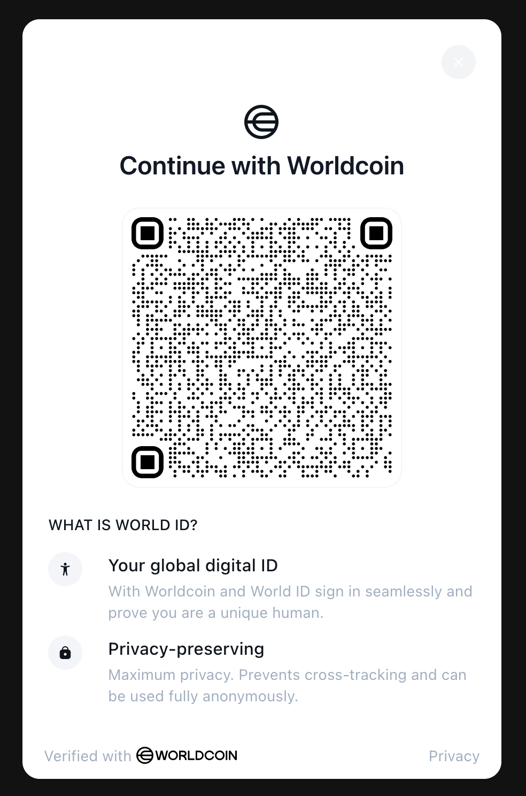
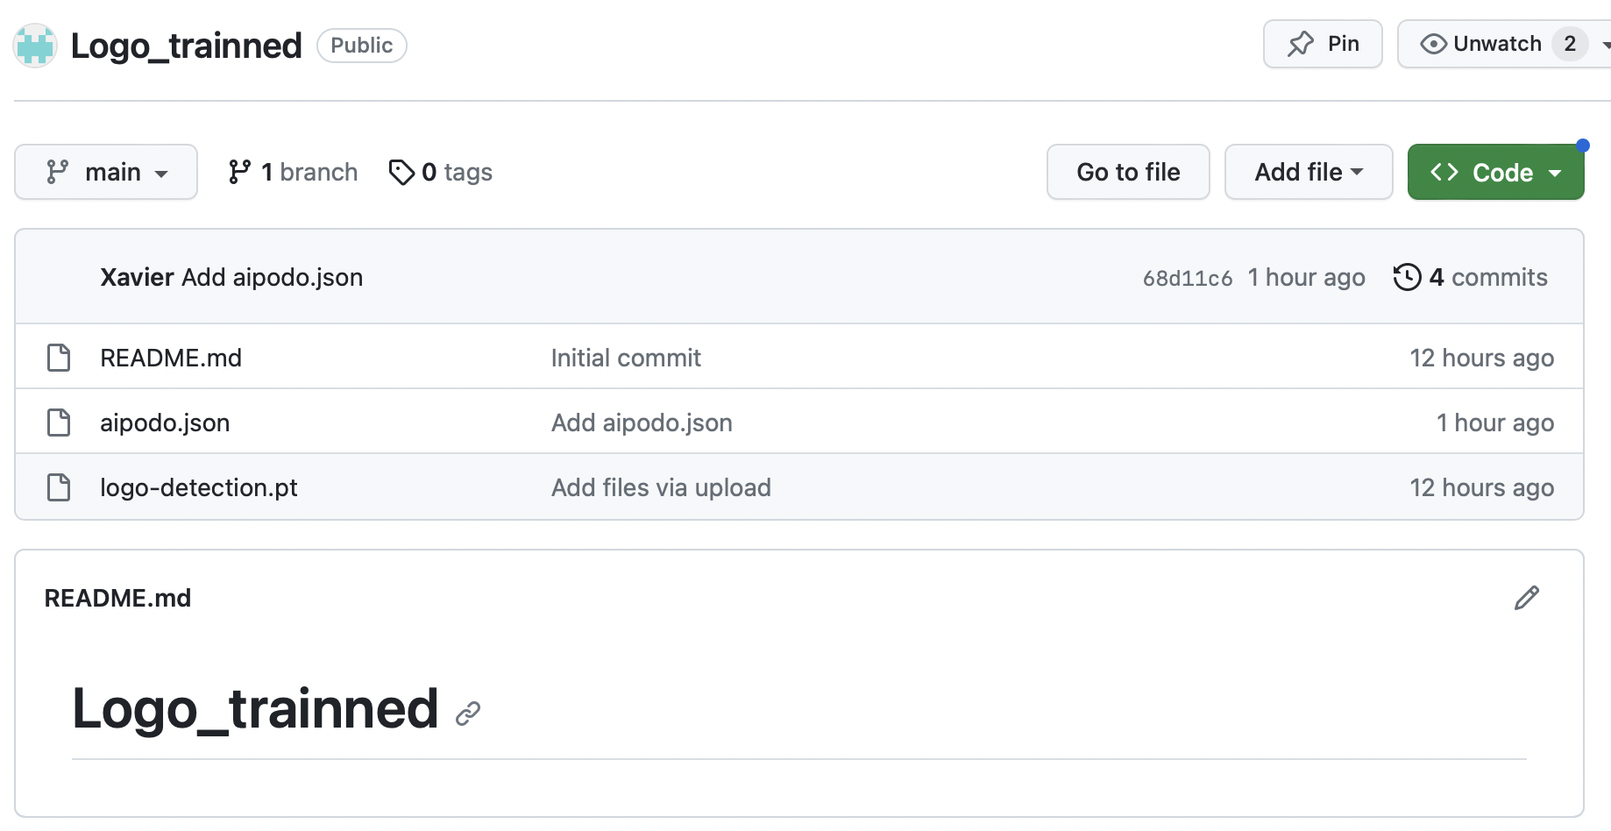
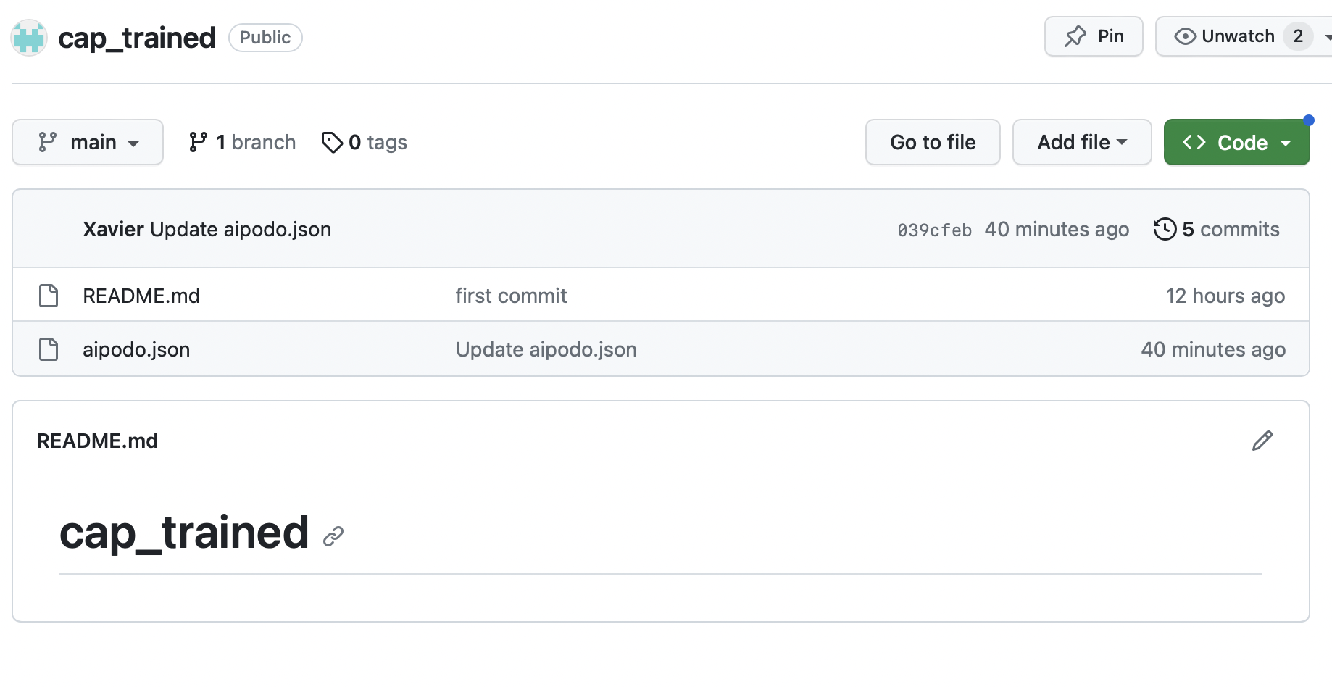
Démo

